Slide 1
WELCOME

Slide 2
SMART AUTOMATION USING MACHINE LEARNING ALGORITHMS AND NEURAL INTERFACE
Guided by,
Ms.Shabna. M
Asst. Prof
Dept. Of CSE
MGM college of engineering & pharmaceutical sciences
Valanchery
Presented By
Akshay Sankar
Hafeed K
Minhaj Fasalu
Nithin

Slide 3
CONTENTS
Introduction
Literature Survey
Proposed System
System Architecture
Implementation
Requirements
Expected Outcome
References
03-02-2021

Slide 4
INTRODUCTION
Smart Home Systems are the subset of everyday computing.
When this application is controlled by machine intelligence to provide circumstance-aware settings.
Here we define an improved Home automation system using multiple machine learning algorithms

Slide 5
LITERATURE SURVEY
NO | PAPER | ADVANTAGES | DISADVANTAGES
1 | Smart Energy Efficient Home Automation System Using IoT | Less Manual Control | Only Have A Web Based Control No Learning System
2 | i-learning IoT: An intelligent self learning system for home automation using IoT | Less Manual Control Learning System | Uses Less Accurate Learning Algorithm
3 | Enhanced Smart Home Automation System based on Internet of Things | Less Manual Control App Based System Can Controlled By Anywhere In The World | Not A Learning System Does Not Have Web Capability

Slide 6
LITERATURE SURVEY
NO | PAPERS | ADVANTAGES | DISADVANTAGES
4 | Enabling IoT automation using local clouds | Less Manual Control Wide range of IOT Device Capabilities APP AND WEB Based | Internet Is Requirement For Connecting More Device Inoperability
5 | Smart Automation using Machine Learning Algorithms | No Manual Control Required No App or Web Based Apps Required Complete Learning System Facial Recognition Internet Is Not A Mandatory | User Must Depend On Some Manual Control Until System Learns User Pattern

Slide 7
PROPOSED SYSTEM – Emotion Recognition Mode
Proposed System Uses SVM (Support Vector Machine)Classifier that is defined by a separating hyper plane.
By using Supervised Learning, the algorithm will output a hyper plane which categorizes new examples.
To use SVM to recognize facial expression, we extract facial landmark key points first and then it is given to SVM classifier to detect user’s mood

Slide 8
PROPOSED SYSTEM – Emotion Recognition Mode
To detect the landmarks that are crucial points required for identifying the emotions/expressions, we use DLib library for python
Normalization of key-points is done by calculating the mean of x and y axes which gives us the coordinates for center of gravity in all facial landmarks.
DLib Library file help to identify eyes,lips,nose,etc attributes on face

Slide 9
PROPOSED SYSTEM – Neural Interface Mode
Proposed Mode Uses EEG(Electroencaphilograph)sensor to detect beta waves from brain
These waves are transmitted over Bluetooth or Wi-Fi to Our system for processing
According to wave pattern respective profiles are switched

Slide 10
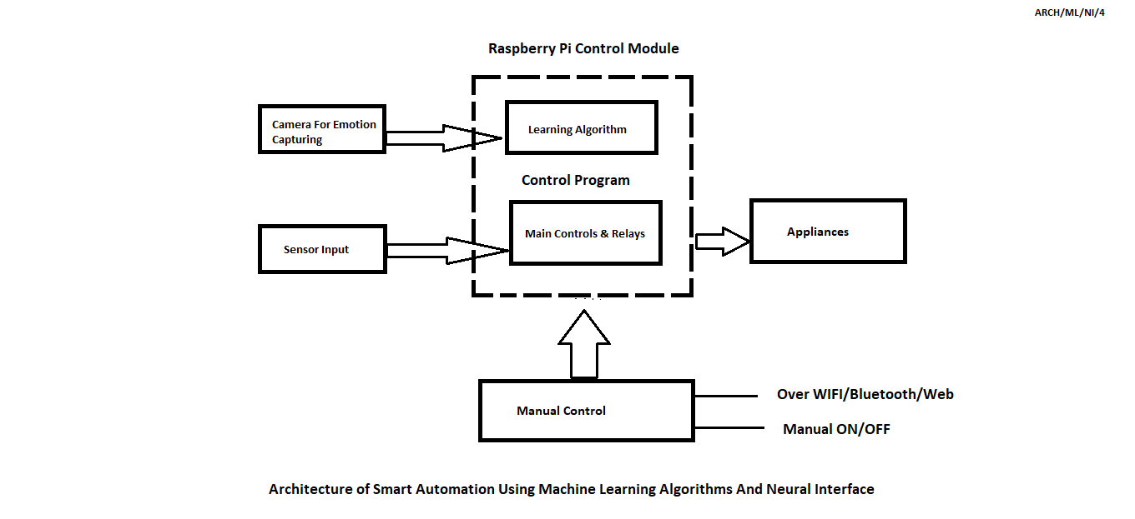
SYSTEM ARCHITECTURE

Slide 11
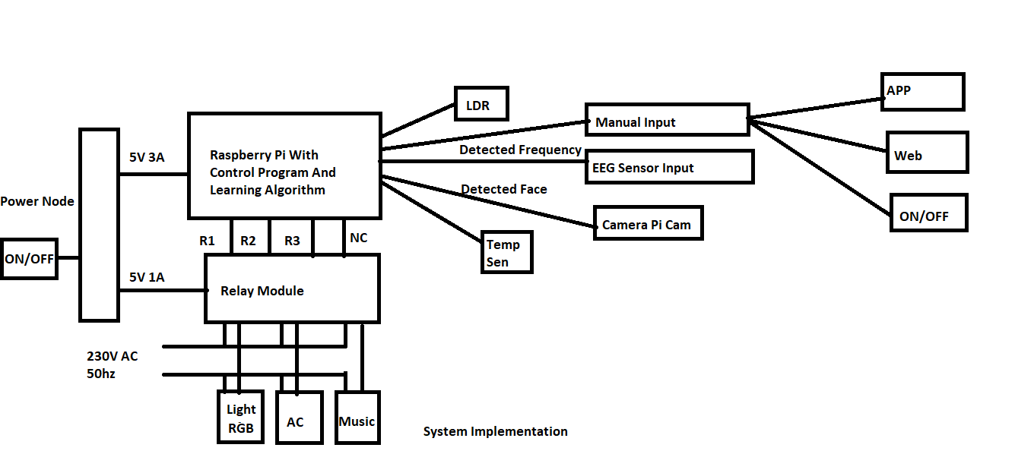
IMPLEMENTATION

Slide 12
REQUIREMENTS
Main Components Required
Raspberry Pi
Relay 5v||230v 10A
PI Cam 720p
EEG Sensor,Temp sensor,LDR,Humidity Sensor,
Services Required
IFTTT
Blynk
Git

Slide 13
EXPECTED OUTCOME
Implement a Intelligent System That controls Usage of Electricity
Proposed System Brings Easiness & Comfort to Users
Bring Manual Control To Zero

Slide 14
REFERENCES
Minaee S, Abdolrashidi Minaee, Shervin, and Amirali Abdolrashidi. ”Deep-Emotion: Facial Expression Recognition Using Attentional Convolutional Network.” arXiv preprint arXiv:1902.01019 (2019).
Amarappa, S., and S. V. Sathyanarayana. “Data classification using Support vector Machine(SVM), a simplified approach.” Int. J. Electron. Comput. Sci. Eng 3 (2014): 435-445.
Van Gent Paul, “Emotion Recognition using Facial Landmarks, Python, DLib and OpenCV,” [Online]. Available:

Slide 15
THANK YOU

